Slide 1
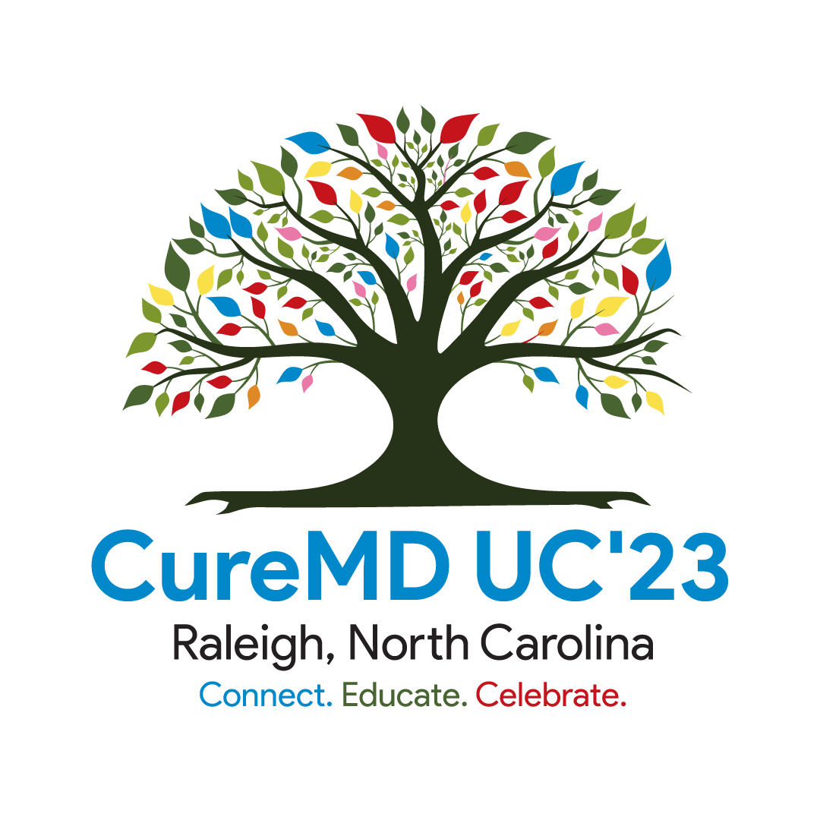
Future Forward
Kristina Cramarossa ~ Sr. Director of Implementations

Slide 2
“People with passion can change the world for the better”
~ Steve Jobs
Notes:
People with passion can change the world for the better - Steve Jobs
The team here at CureMD knows I love a good quote/motto. They provide me a different outlooks and encourages me to think more deeply. When I read this quote, I know it was perfect for today.
I would like to ask you all a question. What did you want to be when you grew up? Maybe there are thoughts of being a Doctors, Firemen, teacher? When this question was asked of me, I wasn't entirely sure but I always gave the same response. I just wanted to make a difference and be passionate about it. Weather it be with family/friends/or in my work. I knew I had to have these key components in whatever I choose.
I believe with anything we do in life or Buiness you must have passion.
Passion is a key ingredient to how we lead our teams here at CureMD.
Passion is apart of the driving force amongst us all to make our EHR the best application for you.
We know that there are many HER's out there. And you have choices. However, I like to think part of what makes us unique and sets us apart from others, is our teams dedication, and passion towards healthcare. CureMD is committed towards providing a solution to help save lives through technological advancements.
Does anyone know how old the Public Sector division is at CureMD? (Interaction with audience)
For those who do not know, this department was born with the vision of two key individuals in this room today
- Omar Ghory - our VP of Public Sector Division, and he has been sharing his passion and dedicating his time with CureMD for the last 22years! Just about as old as CureMD!
- Bill Adsit - Sr. Director of Business Development. Bill has been dedicating his passion for the last 10years with CureMD.
And I was lucky enough to witness these efforts of their vision, development, and execution of the Public Health platform since day one over 10+ years ago.
Fast forward to today, and the CureMD solution is helping communities like yours in over 22 states (need to confirm), and over 400 local health departments! That is amazing!
I can honestly say with complete sincerity that here are CureMD, we have the passion to continue to provide an EHR that will not only help your users be more efficient, but also provide resources to your community to help educate and inform patients on how they can better manage their healthcare.
I am very excited to share with you all today, some insider information behind what our research and development team has been working so diligently on for you and all users of the CureMD Family.

Slide 3
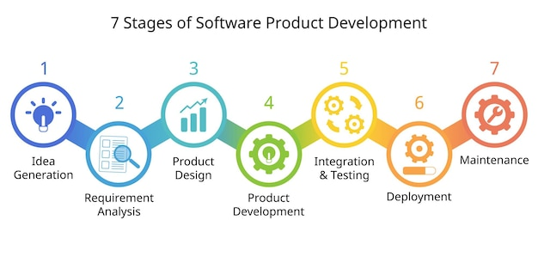
Stages of Software Development
Notes:
Before we dive into our future development and what we have worked on. I wanted to provide the group with a high level overview on the Stages of Software Development:
Speak to :
- IDEA –
- Emphasize – Requirement gathering
- Goes to Product / UI-UX team
- Finally submitted for Product Development (This could take TIME)
- Integrate/Test – Ensure it is aligned/connected with other areas of the application
- Deployment – Release Notes – Executed
- Review / Maintenance – Fine tune any areas.
TRANSITION – Now that you all have seen big picture on how we take an idea > deve/deployment

Slide 4
About 15,000 hours of only development hours since 2019.
Thank you to the agencies who continue to share suggestions towards our application!!!
Notes:
I wanted to share with you all here just SOME of the Public Health Development our team has completed since 2019
Here is a breakdown/image.
15,000 –This is just in development hour ONLY! This does not include the hours of meetings, emails, analysis, requirement gather etc.
THANK THE HEALTH DEPTS WHO CONTINUE TO SHARE IDEAS/SUGGESTION TO HELP IMPROVE OUR PRODUCT

Slide 5
Revolutionizing Public Health Reporting
Endless hours committed to developing TitleX Reporting
Alabama Department of Health- FPAR2.0
North Carolina - LHD Batch Reporting
Colorado - iCare2.0
Kansas - DAISEY
Missouri - FPAR2.0
Maryland - Ahler's
Texas - Ahlers
Ohio - Ahlers
Wyoming - Ahlers
Illinois- Ahlers
Notes:
Part of these hours in this past year was dedicated to Reporting.
As you know, Reporting is extremely important to your operations at the health department.
CureMD is committed and PASSIONATE to provide you with he best reporting.
For those who work with TitleX – You may have known about the changes in FPAR2.0
This is just some of the reports CureMD has worked on to provide you with best reporting.

Slide 6
Enhancing the User Experience
Notes:
Now with the understanding of how CureMD executes our software development…I would now like to share that we are working on a new version of CureMD. And since we all know we are currently using 10g. What do you think is our new version going to be? 11X
We are currently in the design phase for 11x. An many of features both myself and Elizbeth will be speaking is integrated with this new version.
And while our team are working. We are focusing on what to enhance the User Expereince. Through, eliminating user errors, optimizing utilization, time saving, reducing paper, and bringing change to help reduce etc.

Slide 7
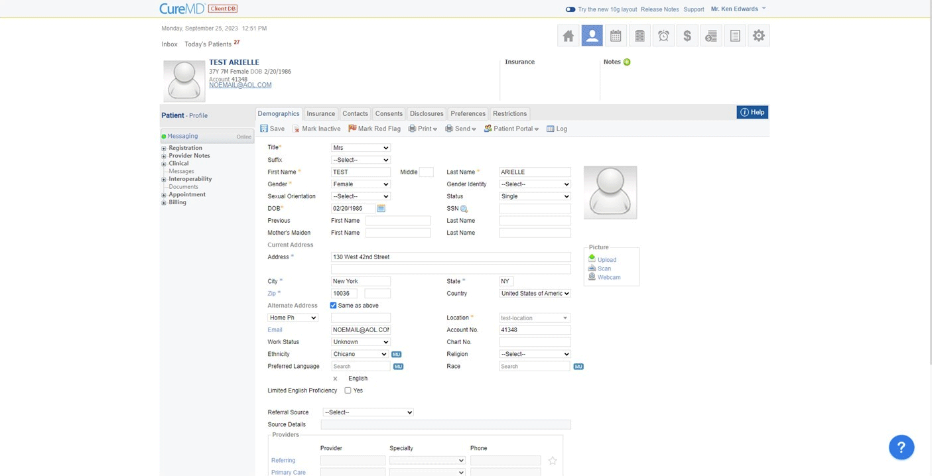
Evolution of User Interfaces

Slide 8
Other Improved UI Include…
Released:
Patient Banner
Advanced Referrals
Advanced Lab Results
Coming Soon:
Today’s Patients
Clinical Overview
Communication Hub
…AND
Notes:
Here are some other improved UI
- Talk about each one and encourage education/breakout sessions
- Highlight Elizabeth and what she will be talking about.
- As the crowd what other frequently used workflow could we be enhancing? I know I have shared this idea with a few of you in the room….

Slide 9
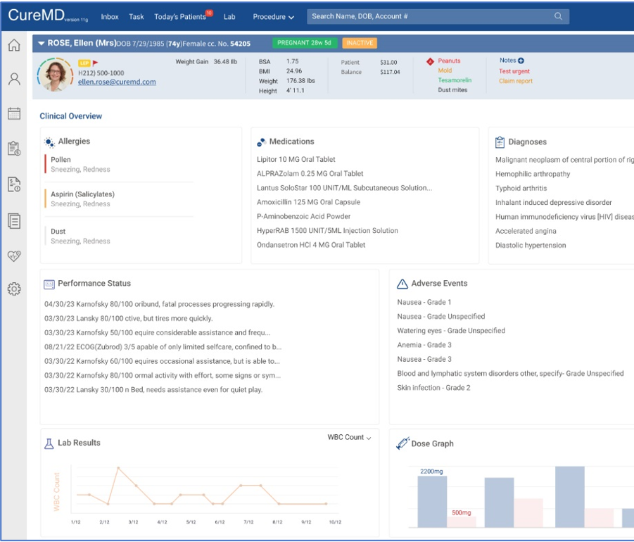
New Provider Note Workflow!!!
Some key benefits included...
View high level summary from previous encounters
Add exam details prior to creating the encounter
Easily add/sort/remove components
Enhanced clinical overview panel
Real time SOAP Text
Easily sign/print/fax encounter
Improved medical spellchecker
Ability to customize left/right side panels
Notes:
The new AI-driven progress note aims to streamline user workflows, enhance usability, and provide valuable insights to enable the providers to conduct personalized treatment for their patients.

Slide 10
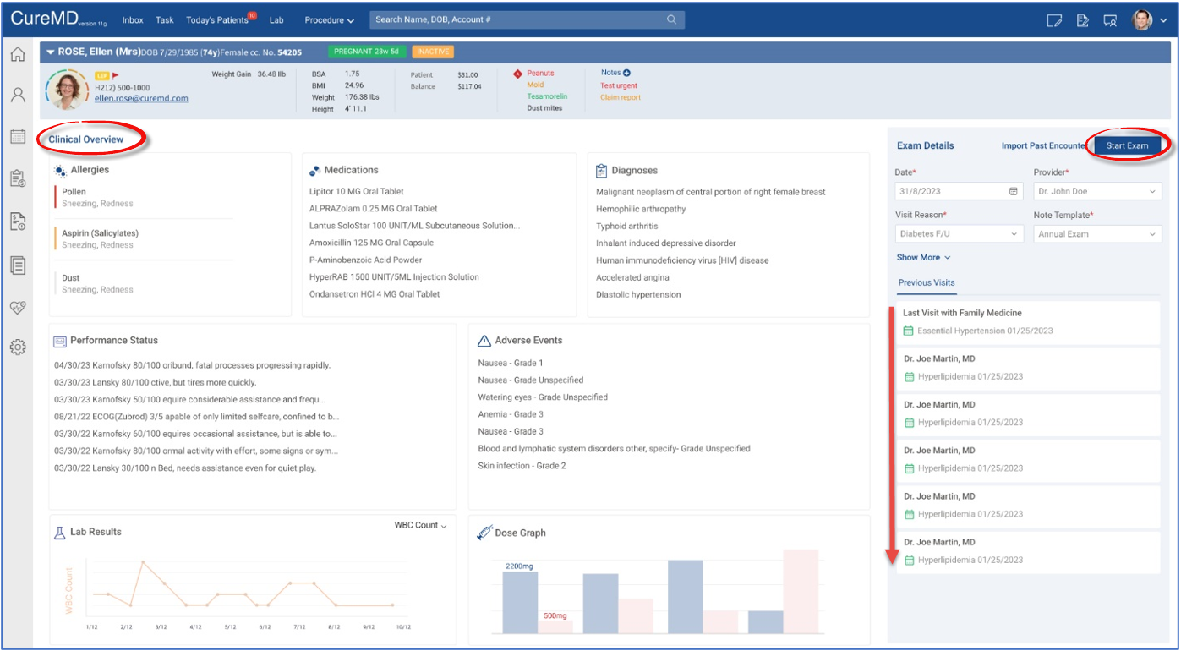
Let’s take a look…

Slide 11
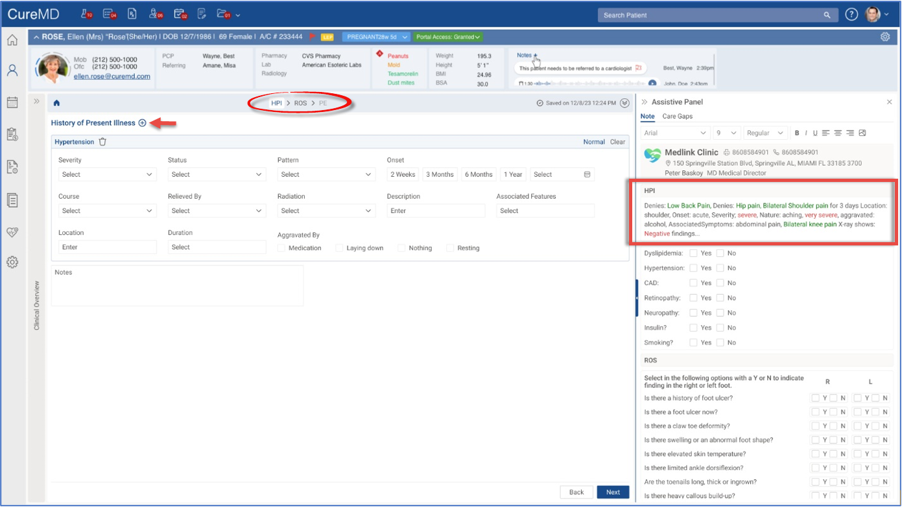
Compliants / HPI
Notes:
After selecting the complaint, the system will display the corresponding fields. As the user fills out the form, the system will generate the narrative on the right-hand side.

Slide 12
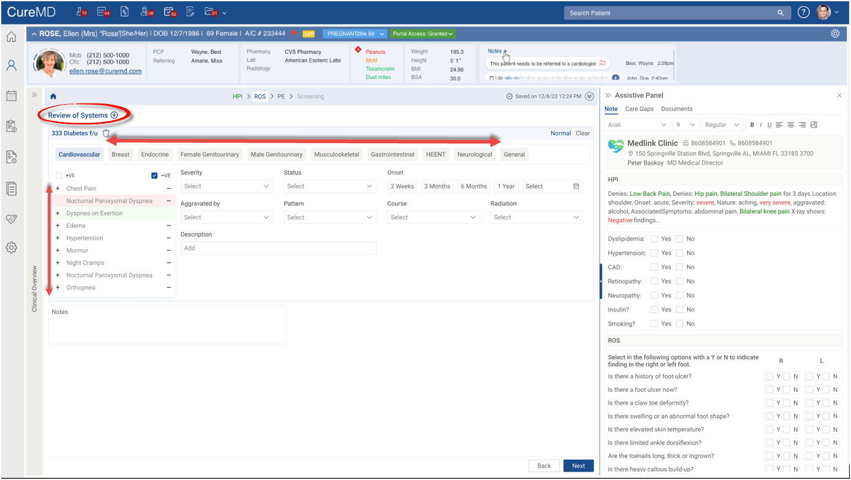
Review of Systems

Slide 13
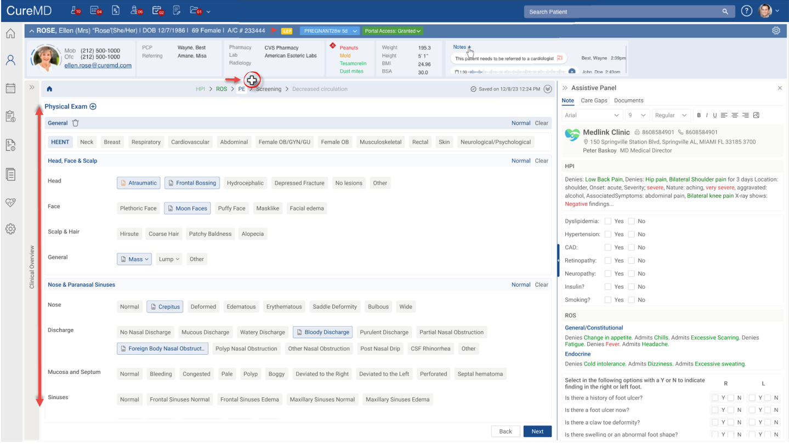
Physical Exam

Slide 14
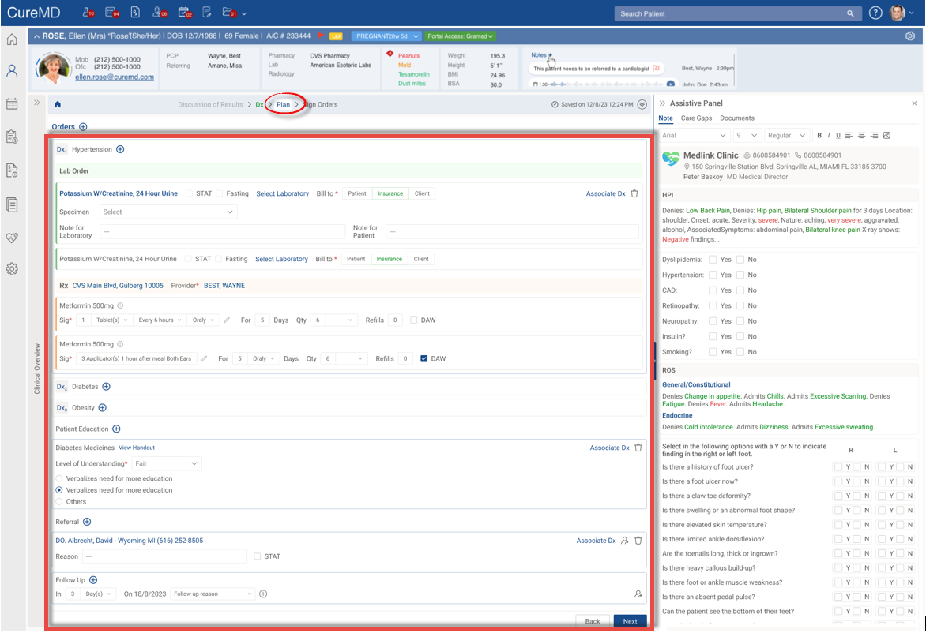
Plan of Care / Orders
Notes:
After the subjective and objective assessment, users can document the 'Assessment and Plan' for the patient by selecting a dx
Who here currently uses our Treatment Plan – Attend a breakout to learn about the new features on how we are enhancing this tool.
Reduce click fatigue / more feasibility on a single screen – Streamline documentation – fore improved efficiency
Define order/plan are easily view in various color depending on their category

Slide 15
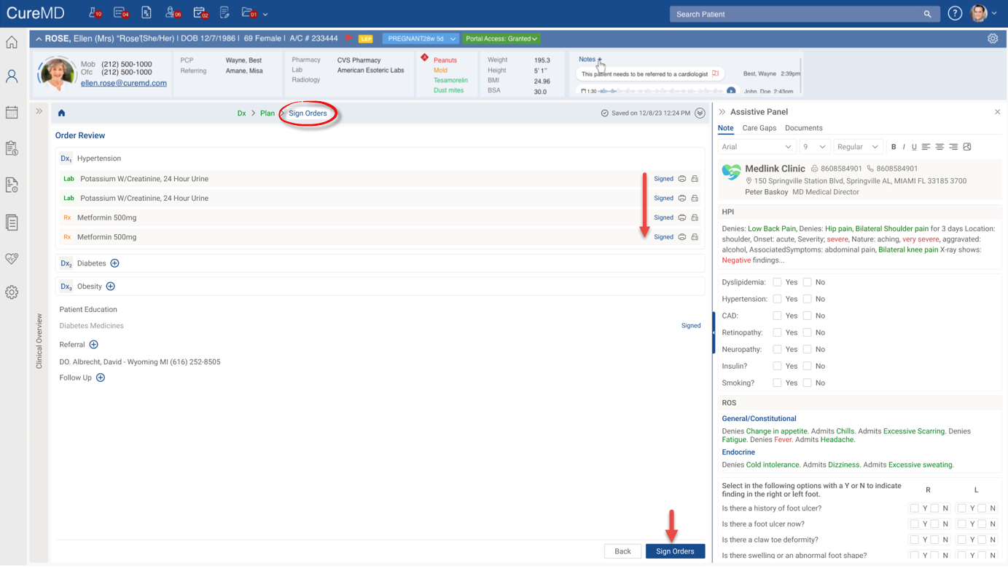
Signed Orders

Slide 16
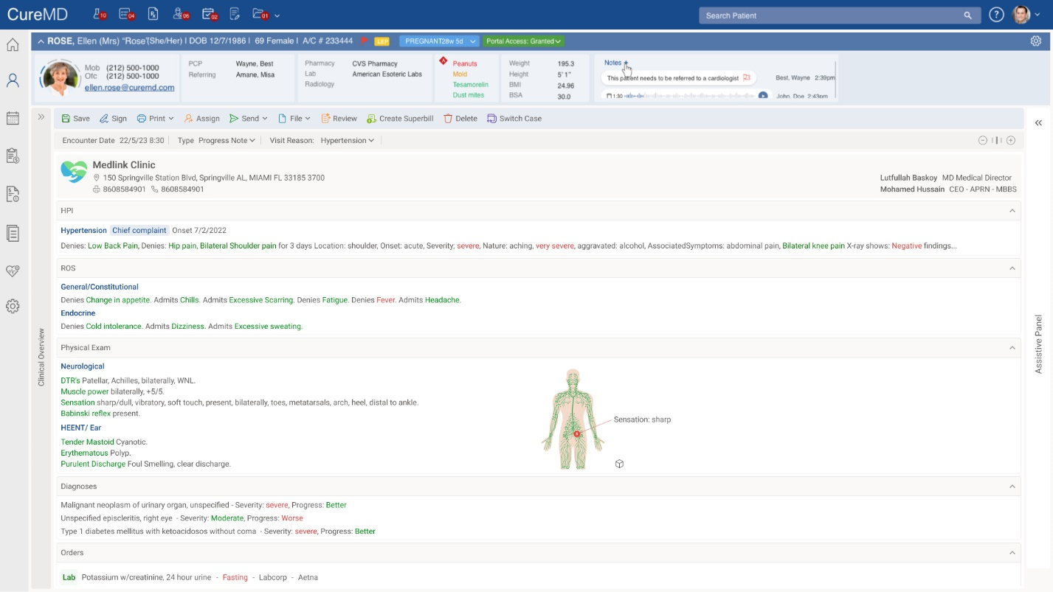
Notes:
Complete SOAP text image

Slide 17
Wait, that’s not all we are working on…
Notes:
Now that we have since what is to come next year in some user workflows, what about the Patient Expereince?
Life expectancy at birth in the United States declined nearly a year from 2020 to 2021, according to new provisional data from the CDC’s . That decline – 77.0 to 76.1 years – took U.S. life expectancy at birth to its lowest level since 1996. The 0.9 year drop in life expectancy in 2021, along with a 1.8 year drop in 2020, was the biggest two-year decline in life expectancy since between 1921-1923.
Causes of death contributing to the decline from 2020-2021 include Heart Disease (4.1%) Chronic Liver Diease & Cirrhosis (3.0%) and Suicide (2.1%)

Slide 19
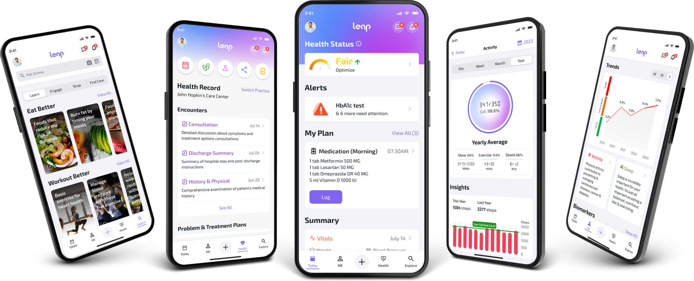
Did someone say Patient Portal???

Slide 20
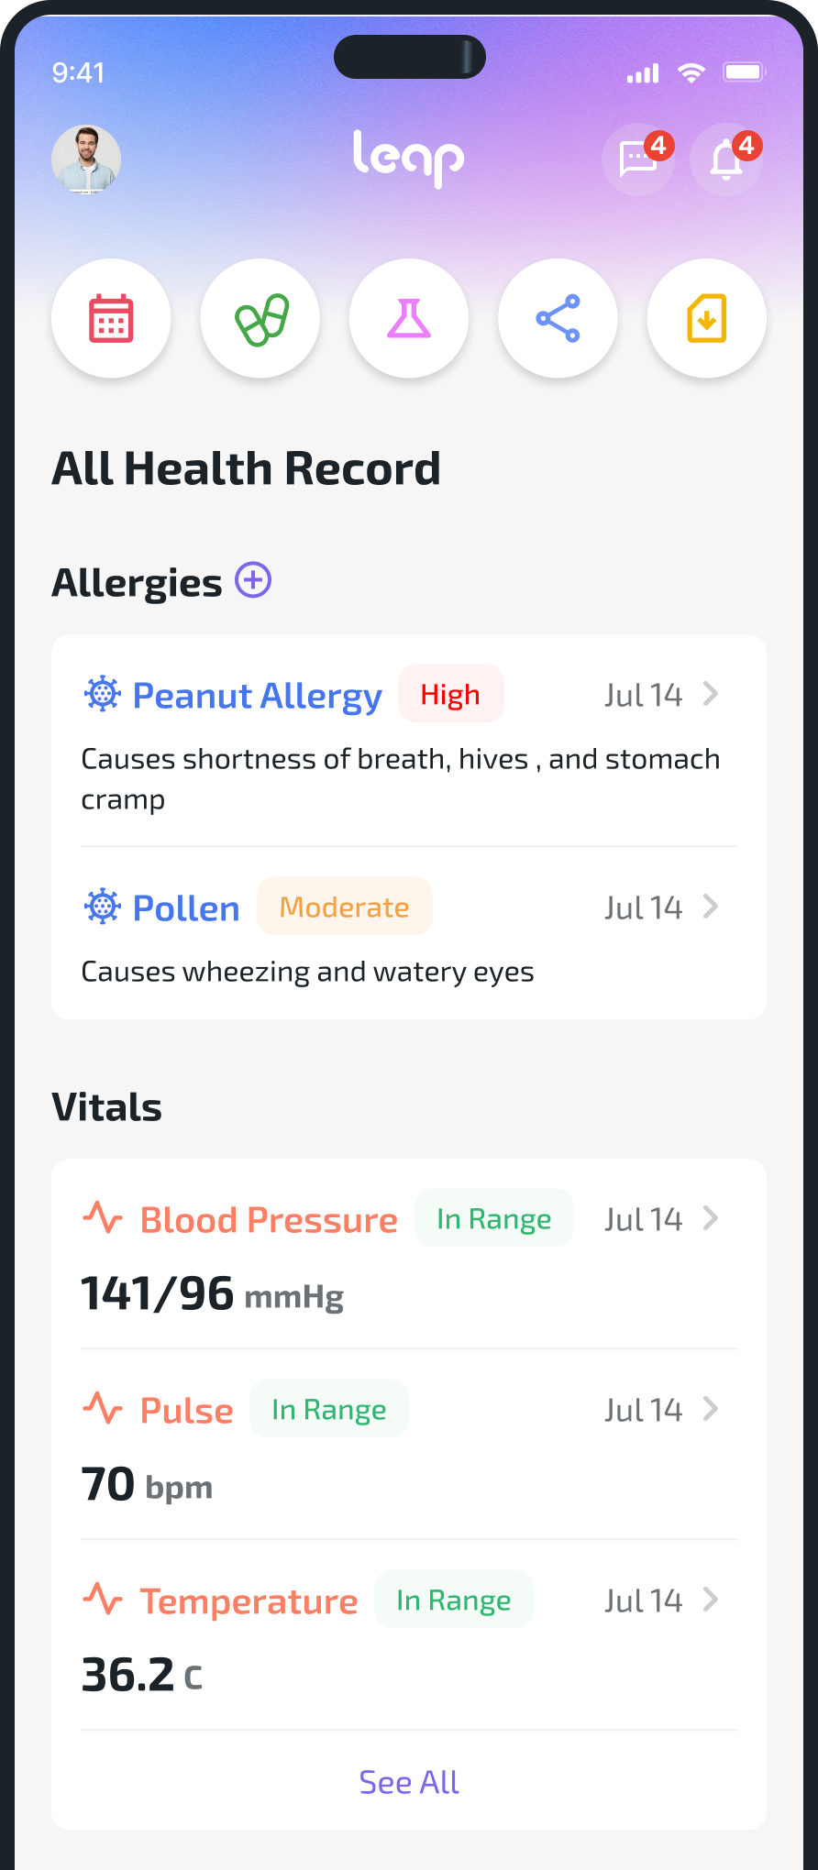
The new patient portal and much more…
Mobile app
Completely free to use for all
Secure & HIPAA compliant
Grants access to health data efficiently
Fully integrated with existing CureMD Product Suite

Slide 21
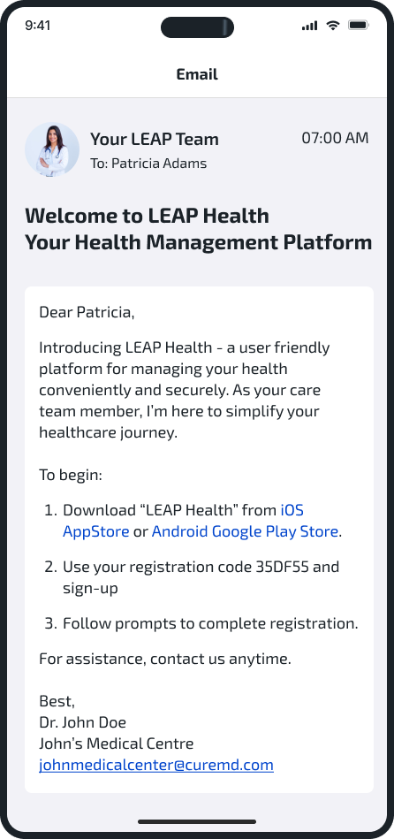
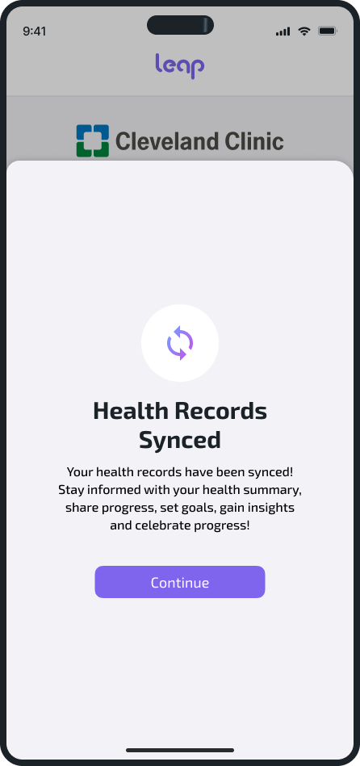
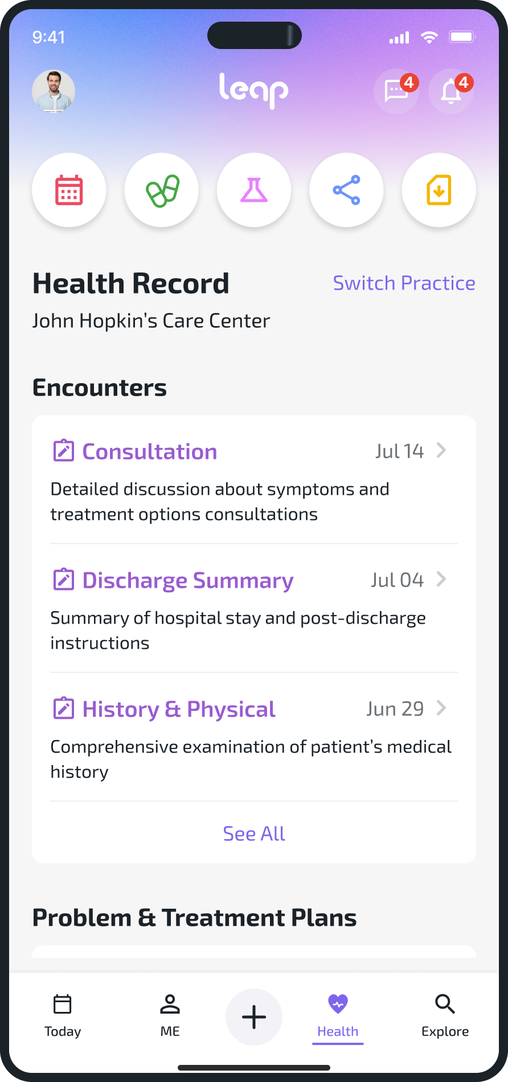
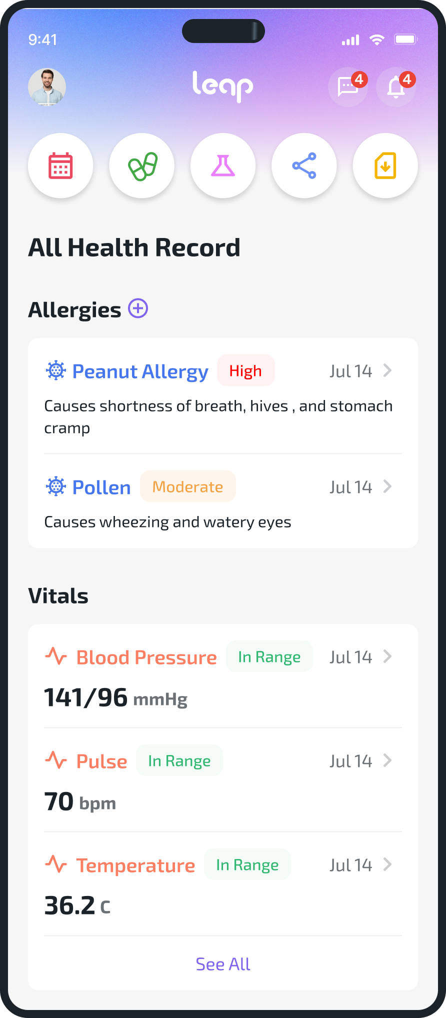
Safe and Easy access to Health Data
Leap provides quick and secure access to their Health Data that’s shared by practices in the CureMD network.

Slide 22
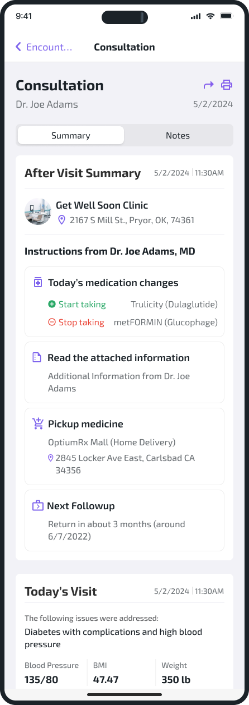
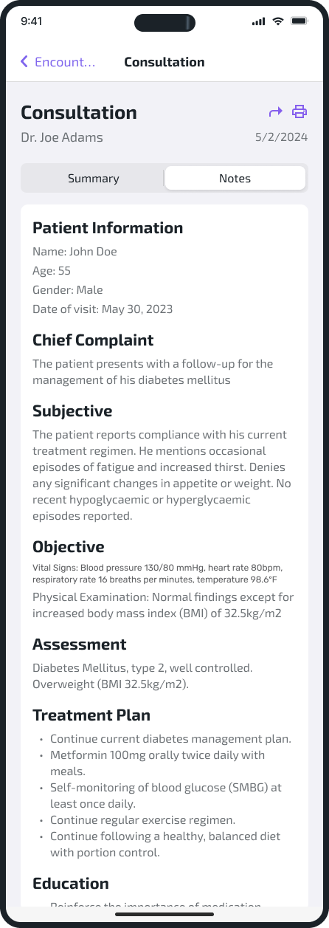
Patient-friendly Summaries
Users get intuitive summaries for their visits and provider’s treatment plans. Highlighting the information, they need effectively / easily.

Slide 23
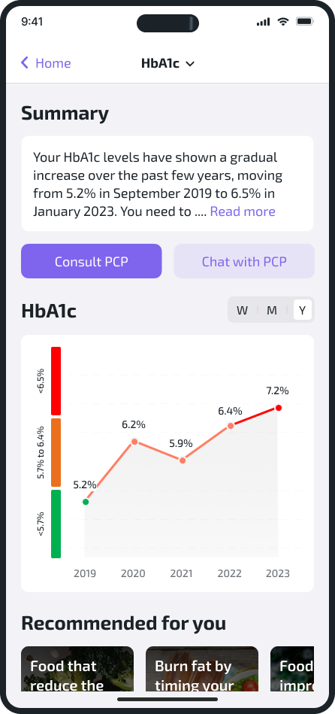
Lab Result Insights
Leap reduces the information-overload in lab results by providing insights of trends seen in a patient’s result history.
It has smart education material and lifestyle recommendations to help patients see improvements in their overall health.

Slide 24
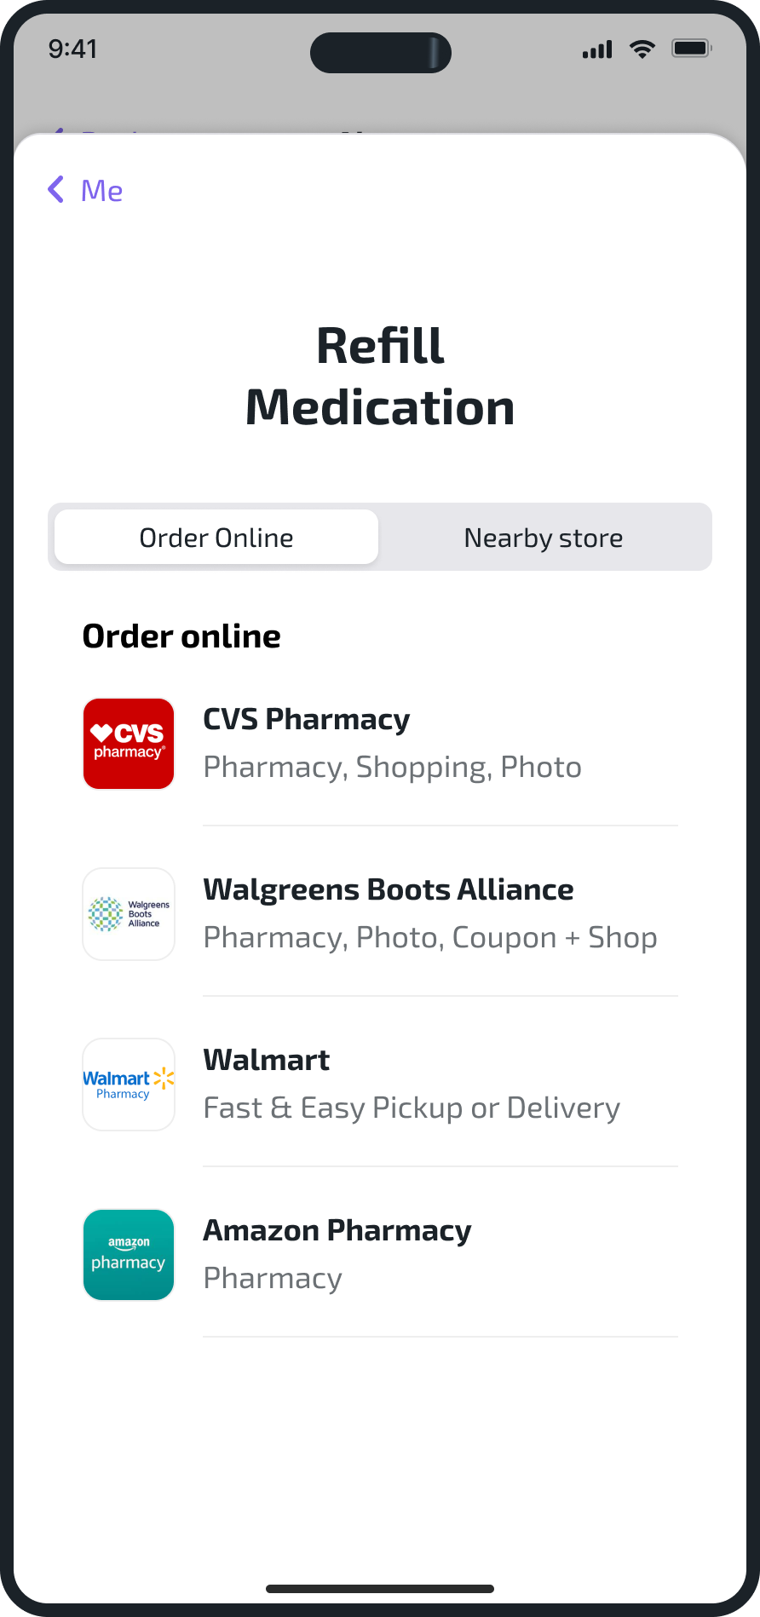
Medication Adherence & Refill Management
Patients can log and set reminders for their medications. They will also get notifications to help them stay consistent.
Leap’s smart recommendations remind patients before their medication runs out and allows them to order / request
refills from within the app.

Slide 25
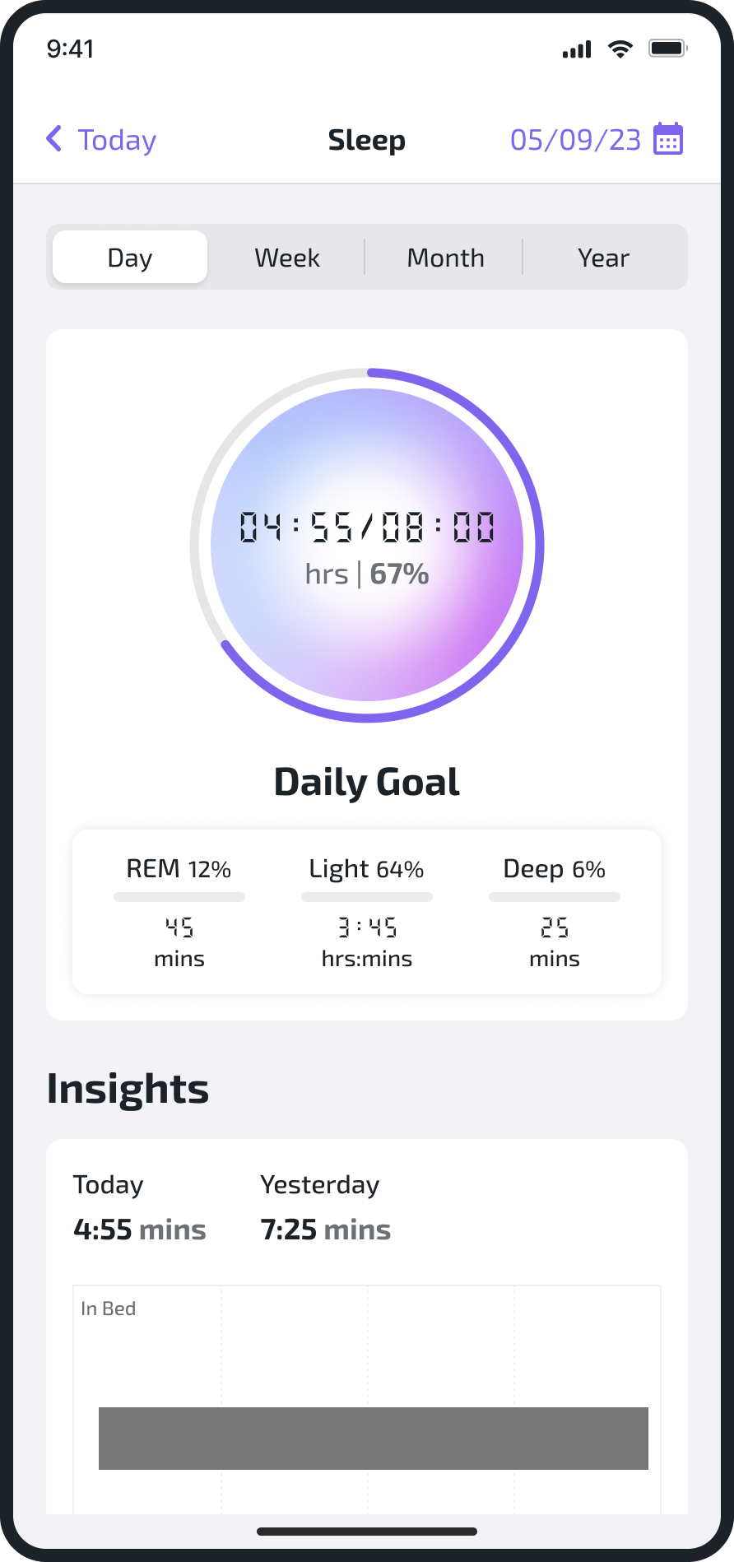
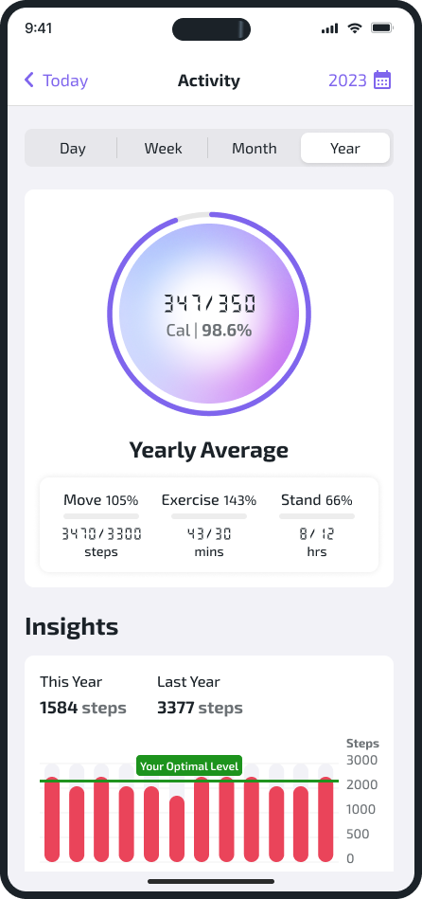
Patient Generated Health Data Sharing
Patients will be able to connect their wearable devices like Apple Watch and Fitbit to monitor their vitals.
Patient will be able to share this data with their practice and synced with the provider dashboard.

Slide 26
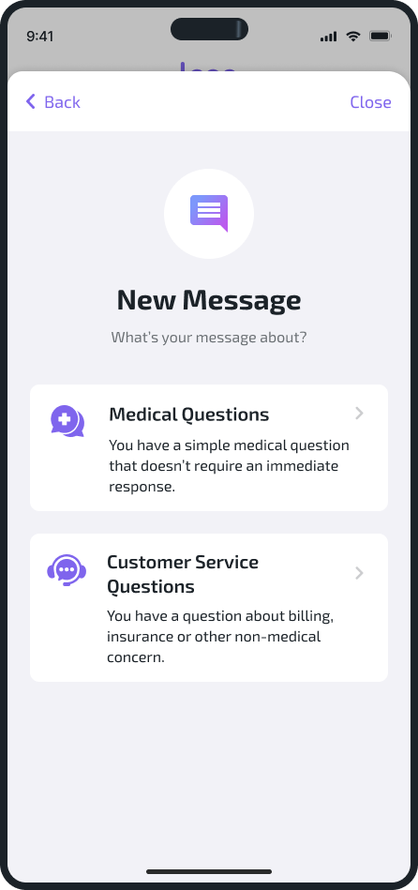
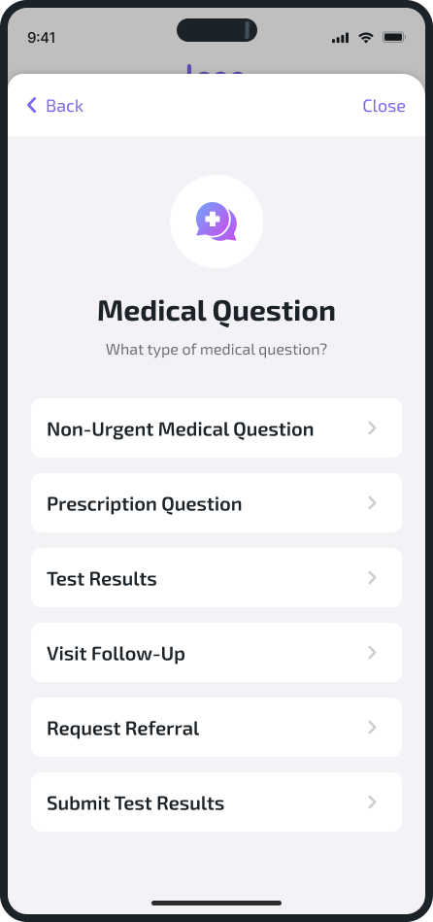
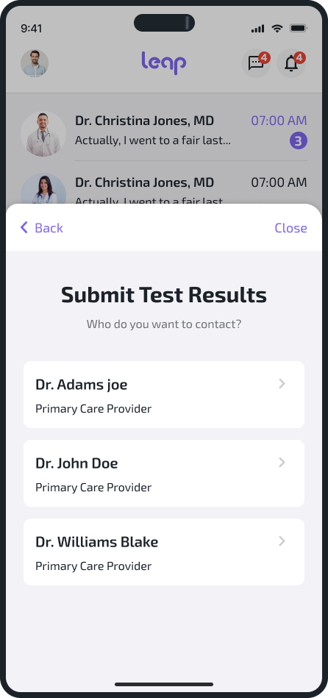
Smart Secure Messaging
Through smart routing patients will be able to message between their Care-Team for efficient and effective healthcare
service delivery .

Slide 27
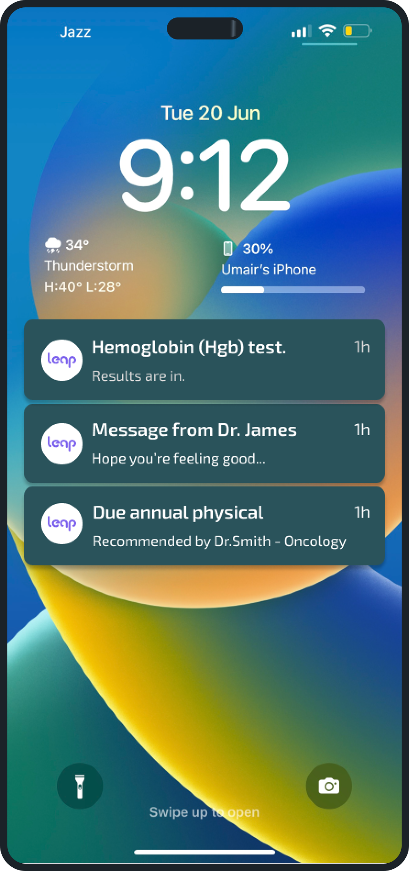
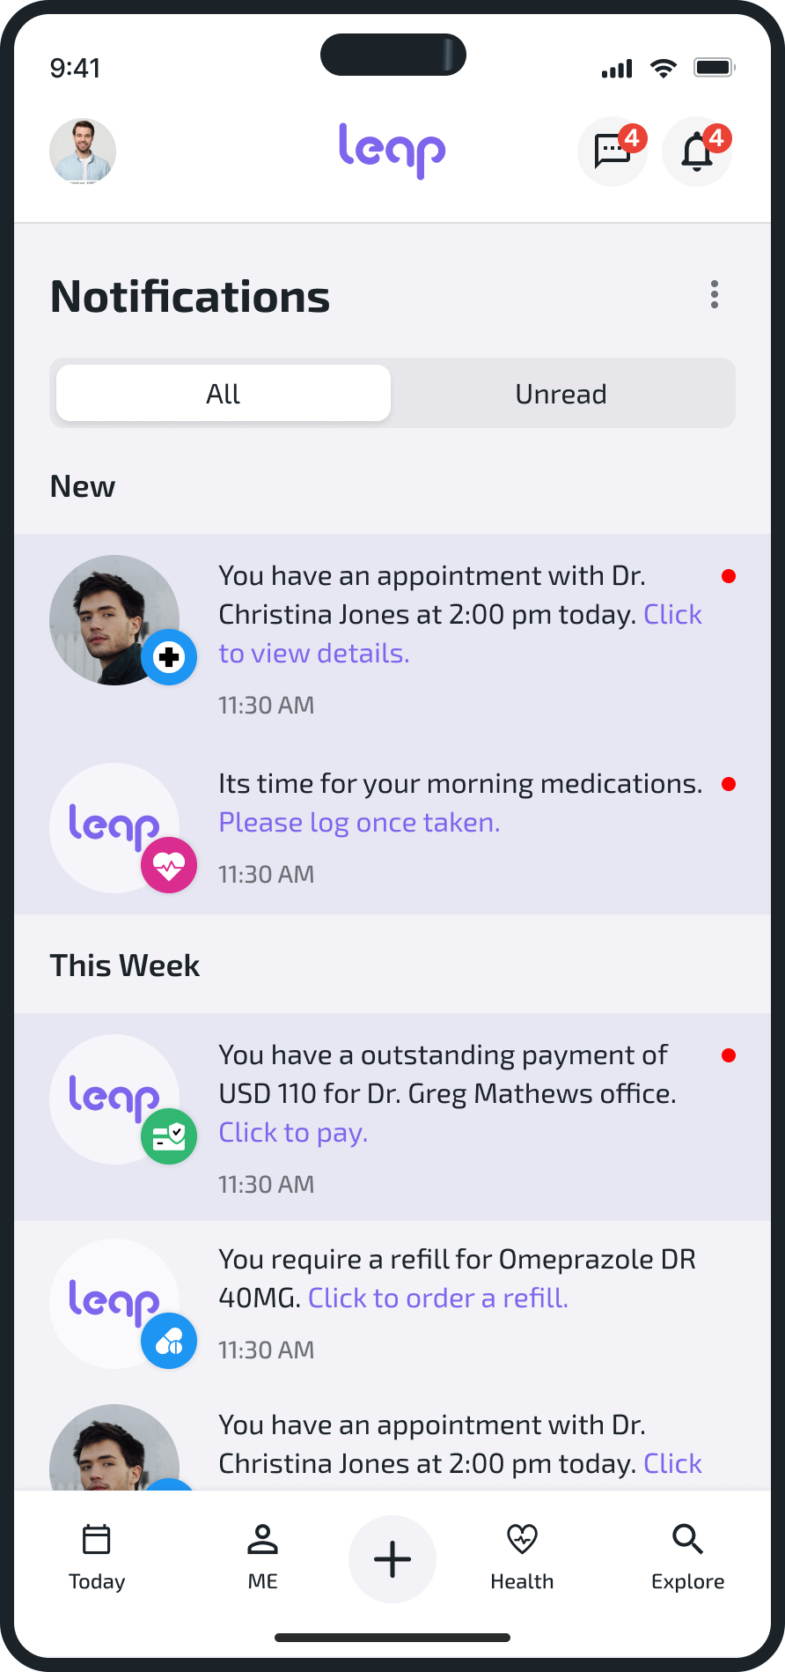
Enhanced Patient Engagement
Through app notifications
Patients can get alerts about their appointments, refills, labs etc.

Slide 28
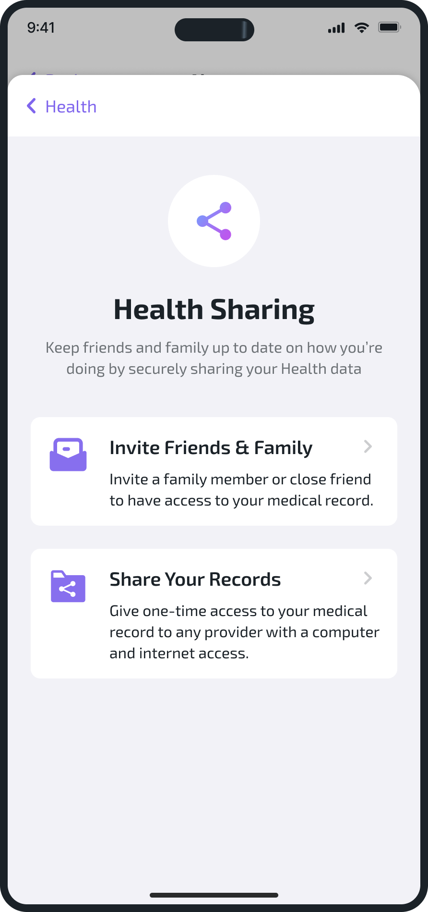
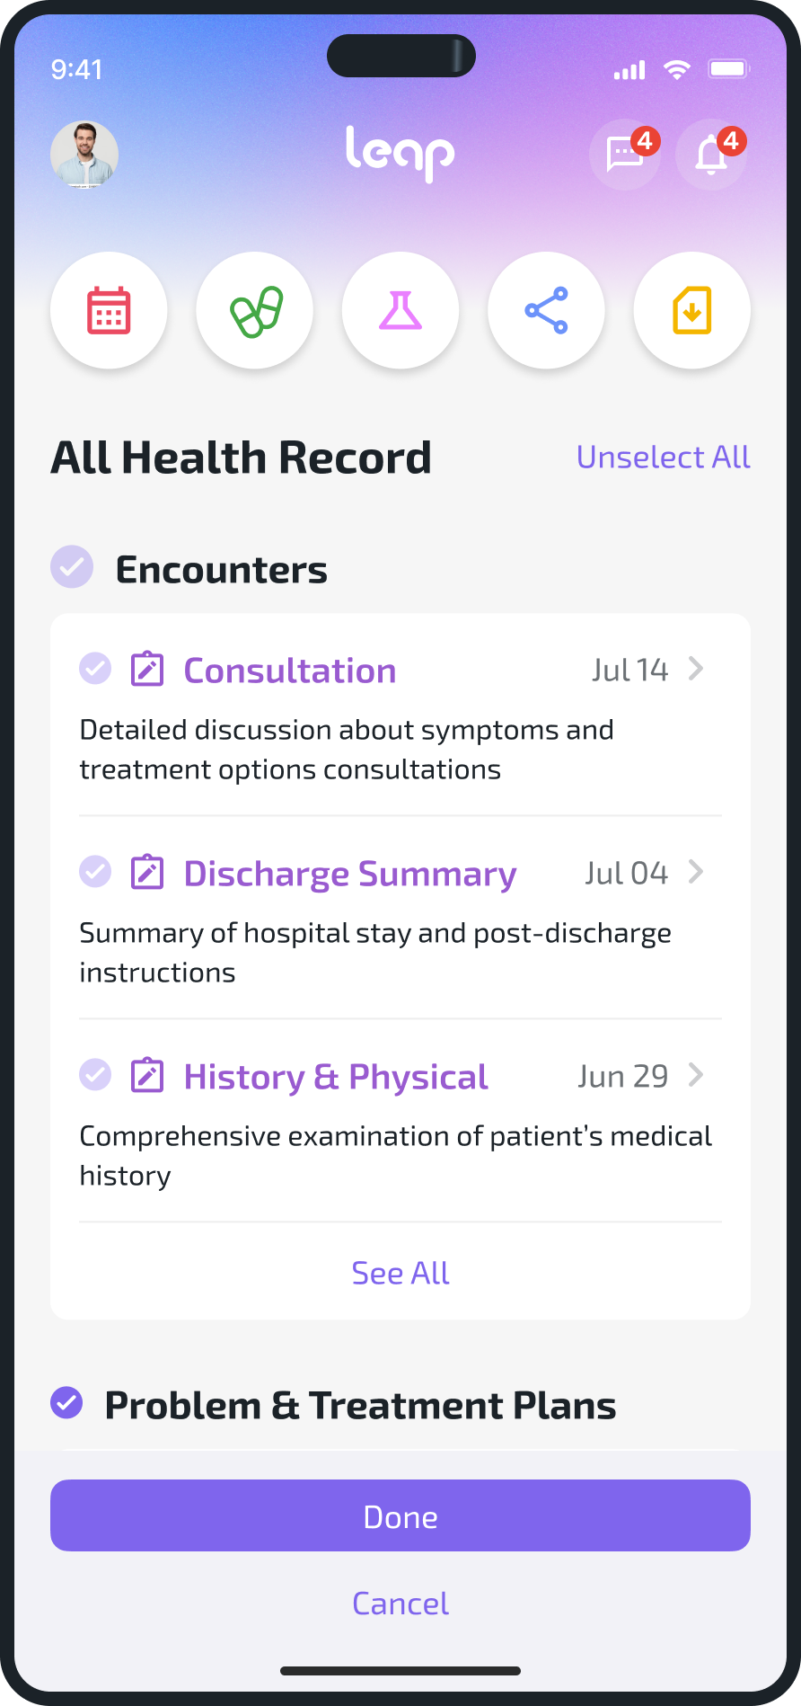
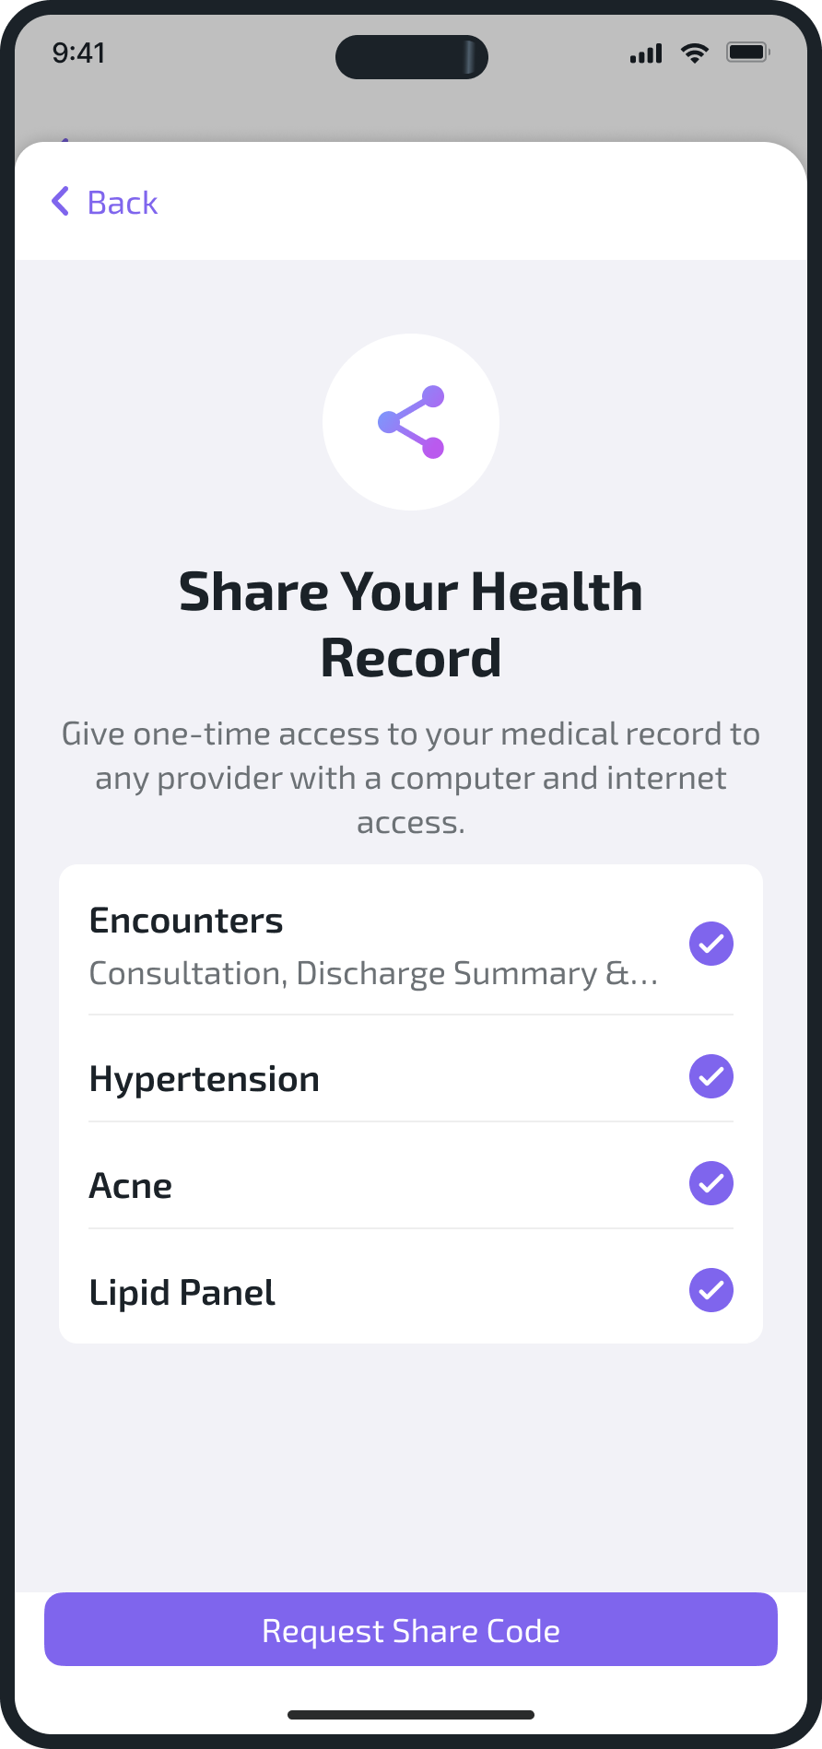
Sharing Health Records
Leap users can share their health records with trusted individuals through the app without having to call their practice.

Slide 29
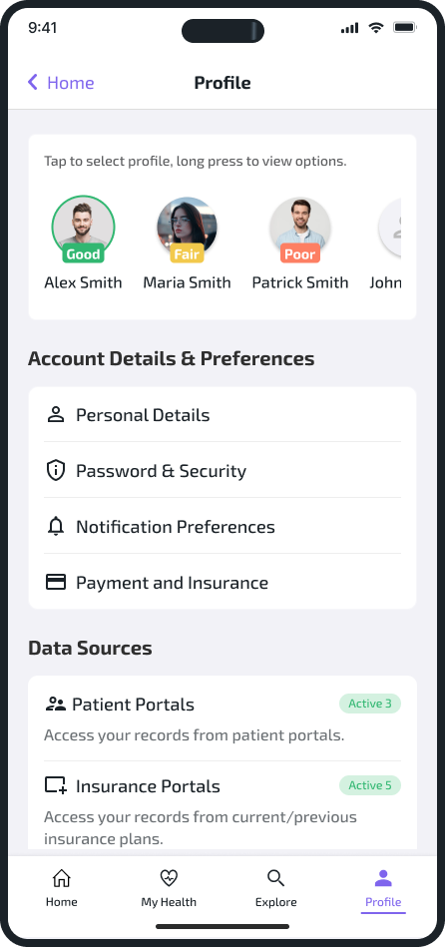
Family & Care-Giver Access
Single sign-in for the entire family and multiple profile management.
Keeping track of your loved one’s easier than ever.

Slide 30
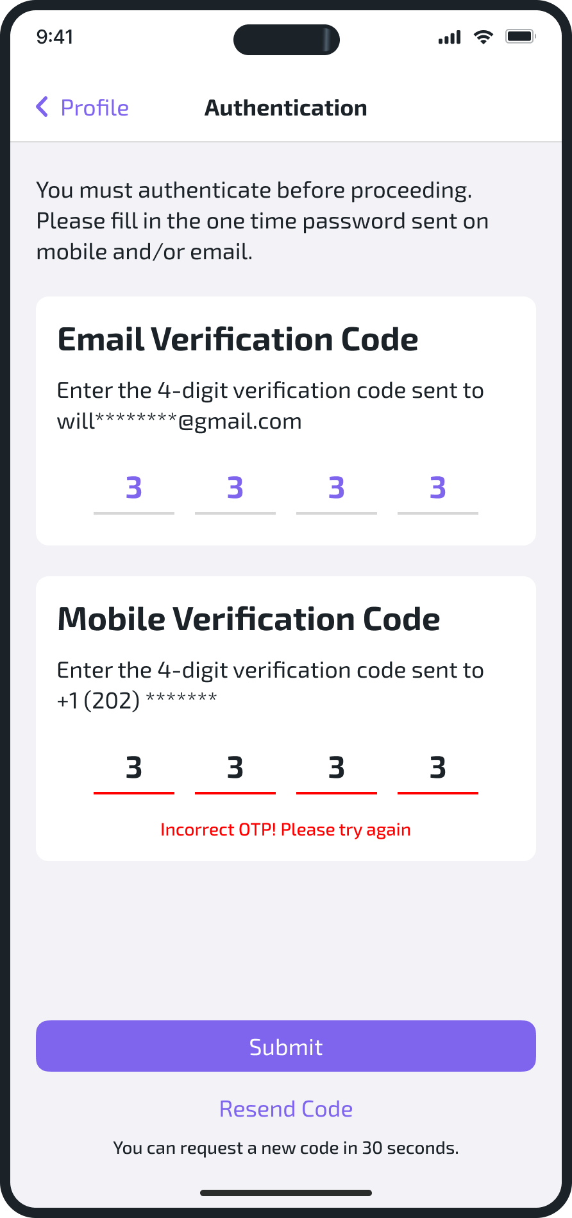
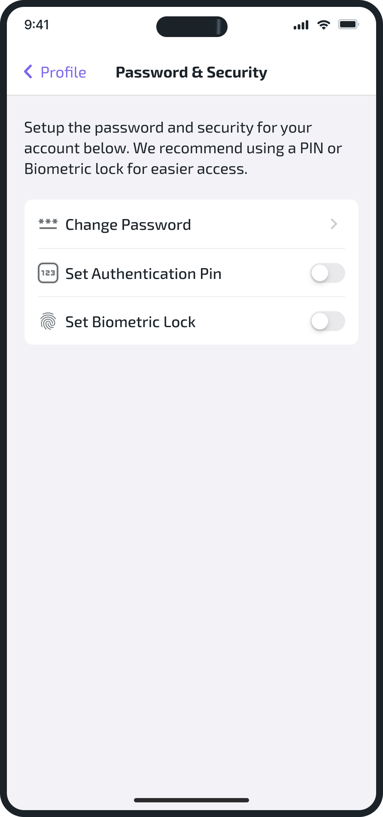
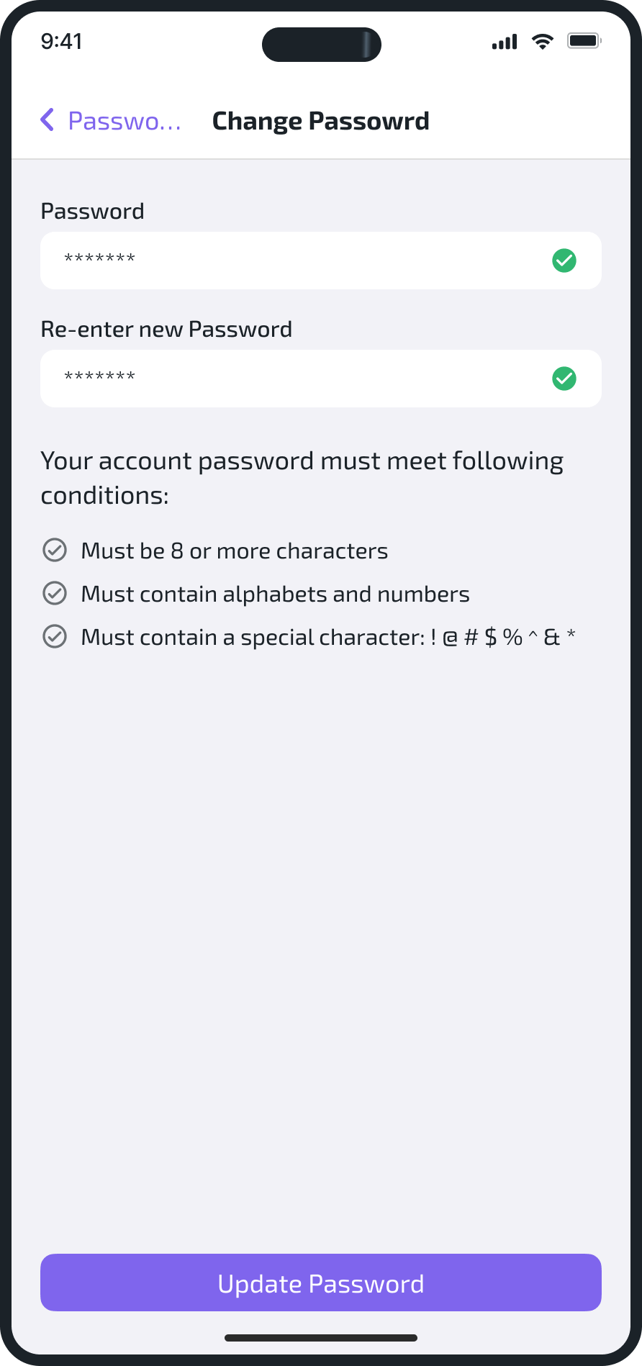
Enhanced Security-MFA

Slide 31
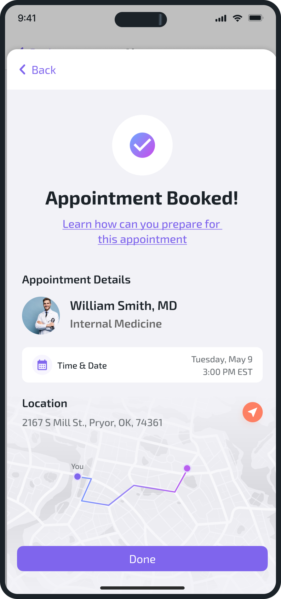
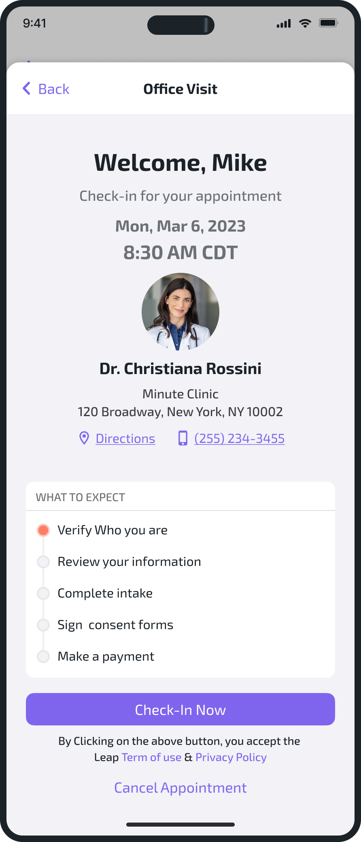
Unified Care-Delivery
Leap offers a cohesive patient journey. Digital Check In, Appointment Booking, Telemedicine, and post visit
interactions are all part of the same app!

Slide 32
More than just a Patient Portal…

Slide 33
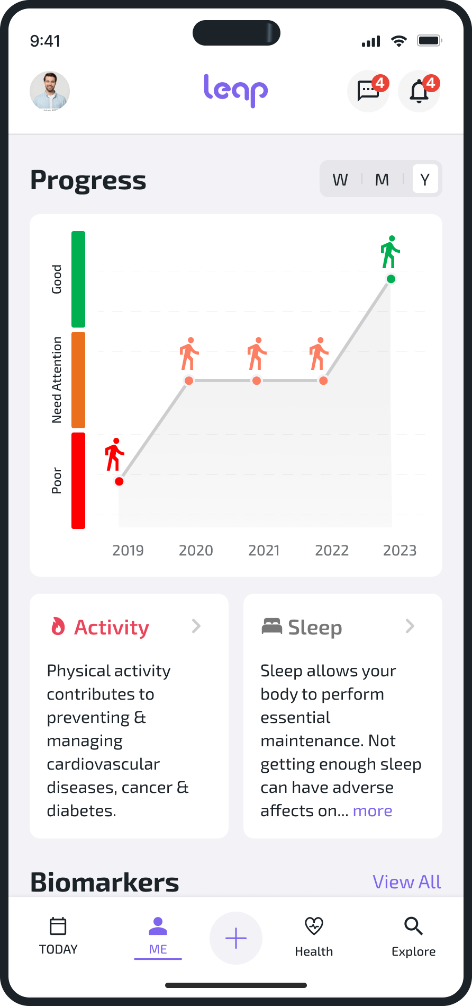
Health Status AI
Provides cutting edge AI models based on a user’s demographics, family history, conditions, lab results and delivers personalized health insights and recommendations.

Slide 34
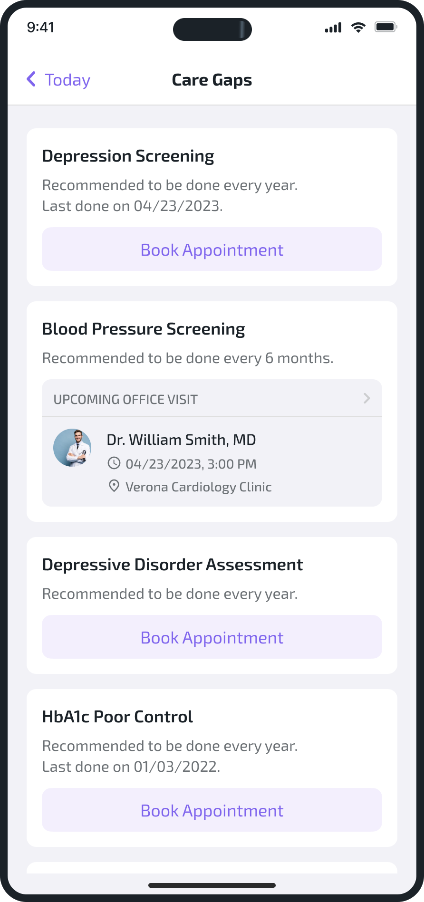
Gaps in Care
Leap helps users take control of their health by providing smart reminders for follow-up appointments, mitigating any
overdue check-ups based on patient demographics and risk factors.

Slide 35
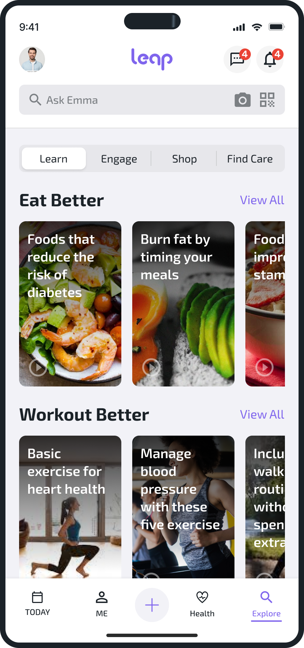
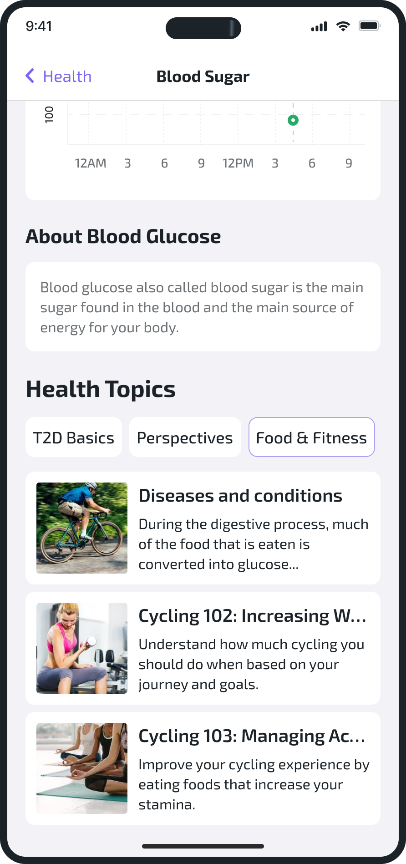
Personalized Education
Educational recommendations appear along side their tests, procedures, vitals and medications.
Educational hub where users can find articles and videos.

Slide 36
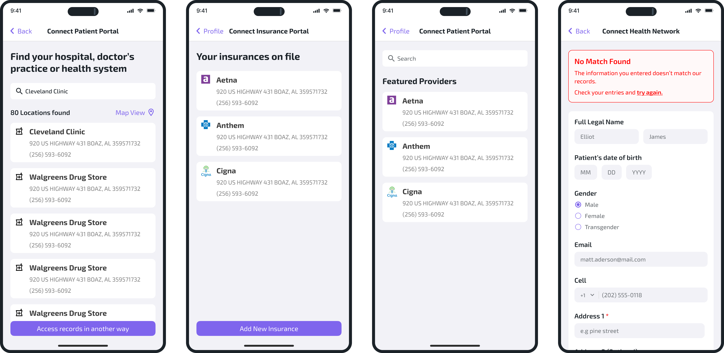
Universal Health Records
Users can get access to health records and information beyond what was shared by their CureMD practice.
This data can come from Health Information Exchanges (HIEs), providers, insurance portals, hospitals and patient portals.

Slide 37
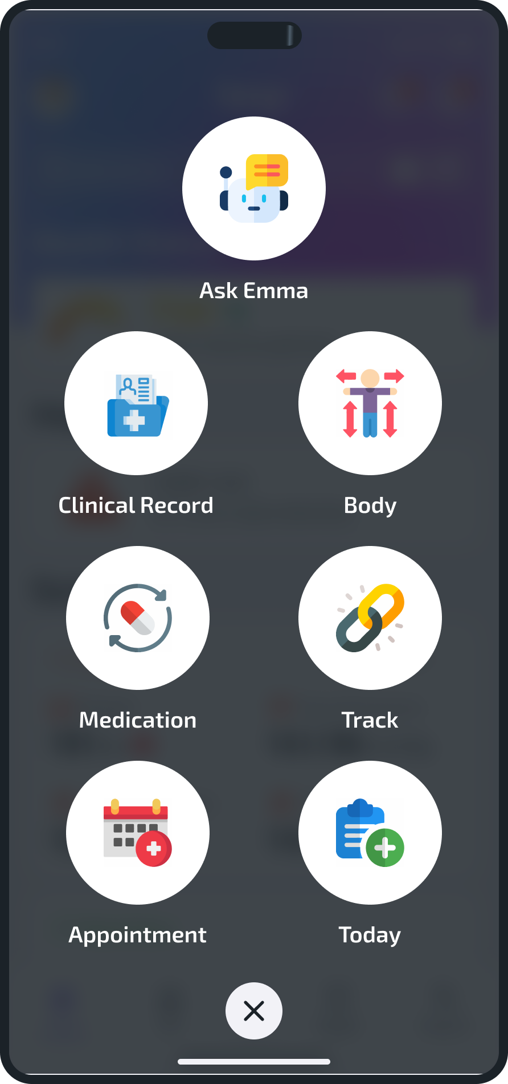
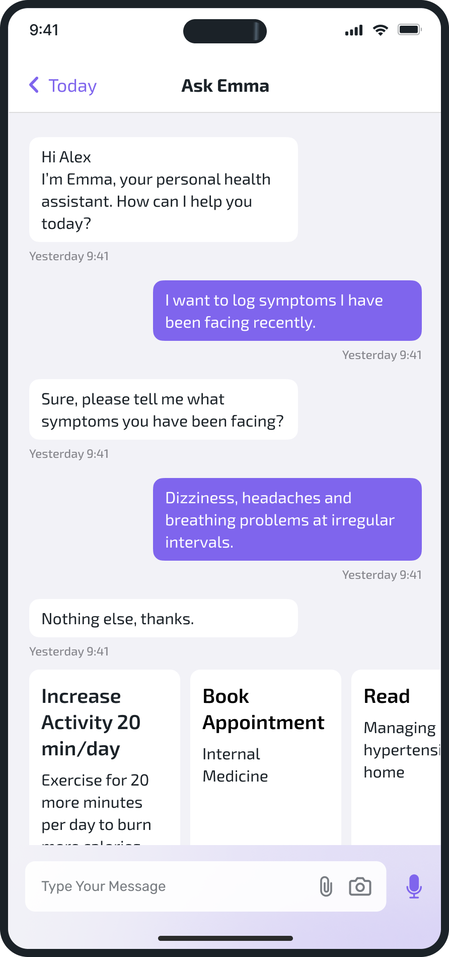
Conversational AI
Our AI chatbot allows patients instant updates on their treatment plan, answers questions about medications,
helps book appointments and a lot more.

Slide 38
Launching early 2024!
Let’s explore the app…

Slide 39
THANK YOU!!!

